Slide 1
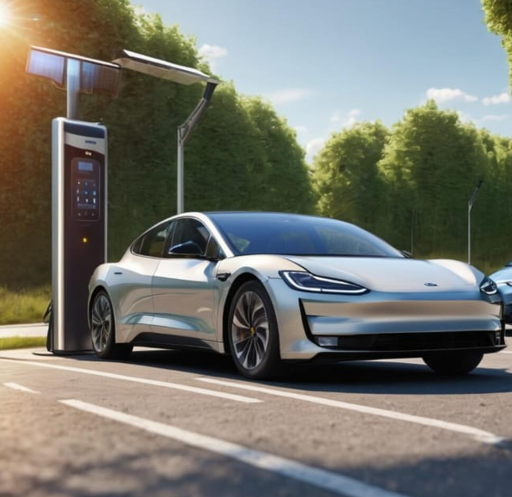
SOLAR TREEAI EQUIPPED
RAJA RAJA CHOZHAN V K
RAJA B
NANDAGOPAL J
HARISH K S
SWETHA SAMY
SOLAR TREE-SOLAR TREE-SOLAR TREE-SOLAR TREE-SOLAR TREE-SOLAR TREE-SOLAR TREE

Slide 2
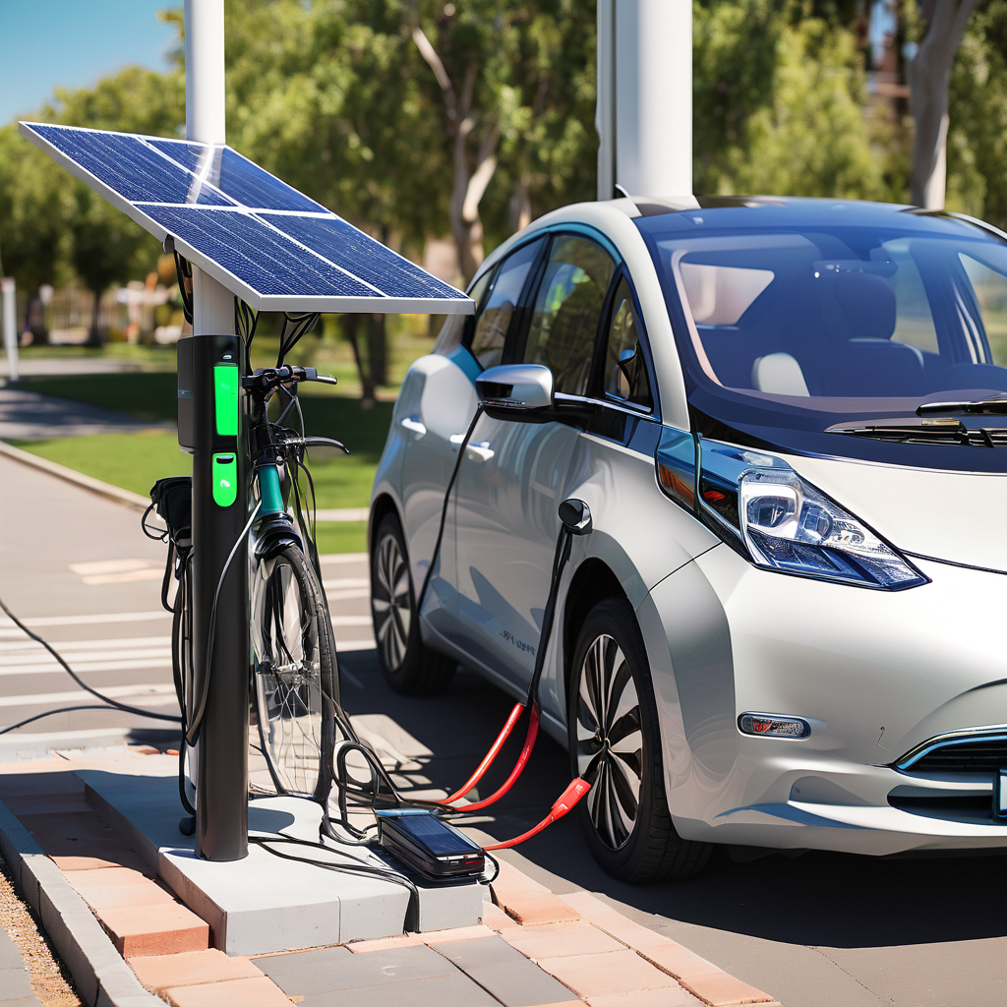
NAME REASON
The name "Solar Tree" draws inspiration from the natural phenomenon of phototropism, where plants orient themselves towards the sun to maximize light exposure. Similarly, our Solar Tree mimics this behavior by dynamically adjusting its position to face the sun throughout the day. By harnessing solar panels mounted on a pole, the Solar Tree captures sunlight efficiently, much like how plants optimize photosynthesis. This innovative design ensures optimal energy production, reflecting the synergy between nature-inspired principles and renewable energy technology. Thus, the name "Solar Tree" encapsulates both the concept of harnessing solar energy and the idea of mimicking nature's efficiency in capturing sunlight.
NAME REASON-NAME REASON-NAME REASON-NAME REASON-NAME REASON-NAME REASON

Slide 3

VISION AND GOAL
"India Vision 2030" serves as a strategic roadmap for the nation's progress and development, focusing on economic growth, social development, environmental sustainability, and technological advancement. Aligned with this vision, our project aims to promote renewable energy and achieve sustainability outcomes.
Prime Minister Narendra Modi's initiative to install 1 crore solar panels is a key component of India's broader efforts to advance renewable energy and sustainability goals. By significantly expanding the country's solar energy capacity and reducing reliance on fossil fuels, this initiative addresses climate change, enhances energy security, and fosters economic growth.
VISION AND GOAL-VISION AND GOAL-VISION AND GOAL-VISION AND GOAL-VISION AND GOAL-VISION AND GOAL

Slide 4
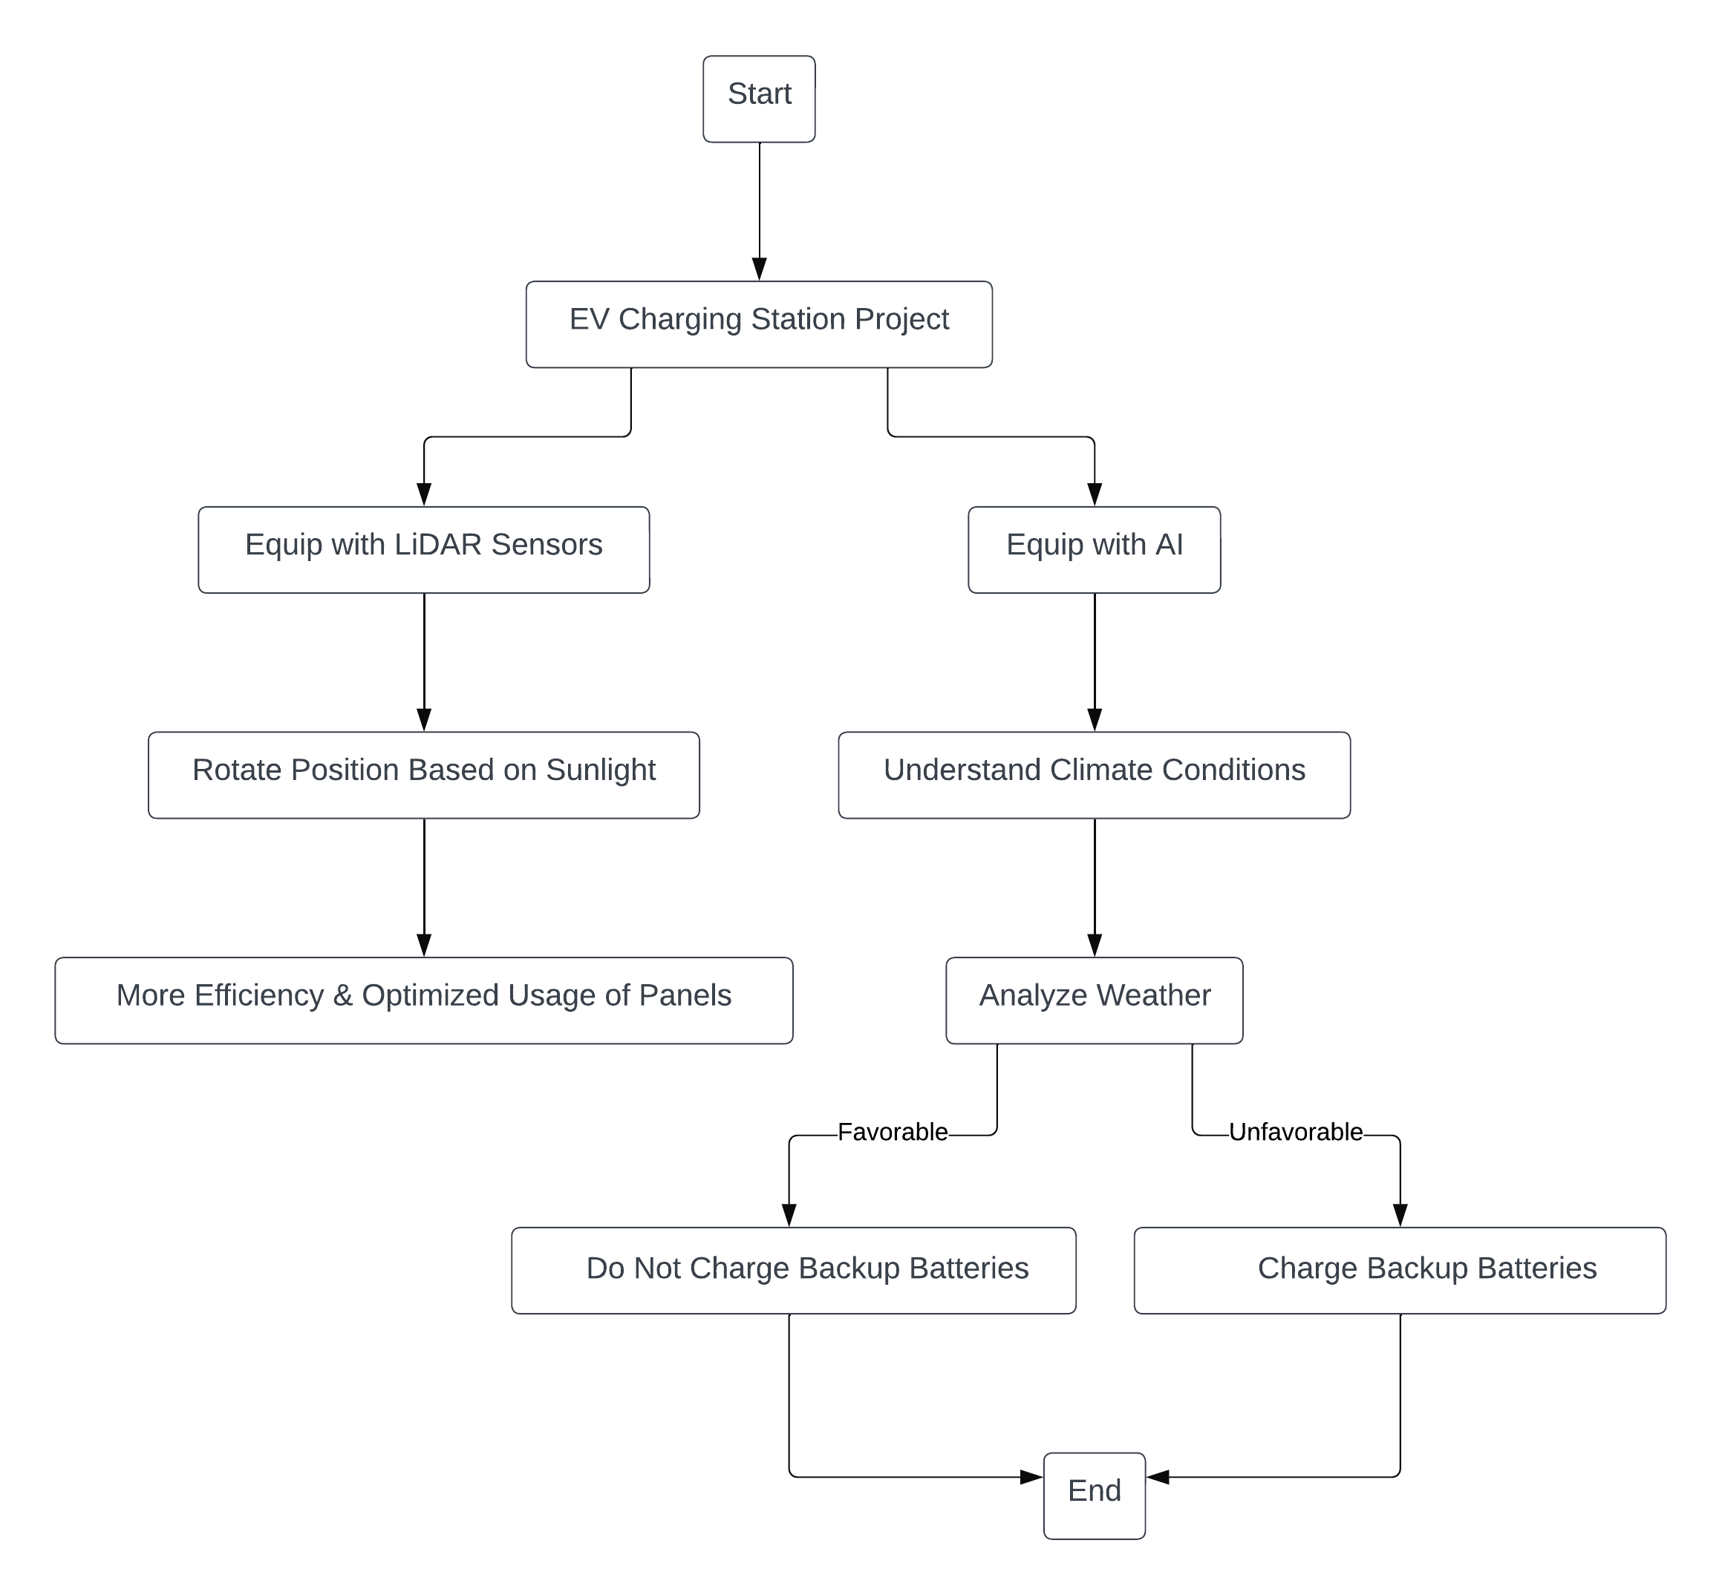
METHODOLOGY
METHODOLOGY-METHODOLOGY- METHODOLOGY-METHODOLOGY- METHODOLOGY-METHODOLOGY
The workflow for the EV Charging Station project begins with gathering data from the charging station itself, checking if LiDAR sensors are installed. If present, these sensors activate to assess sunlight intensity. If sunlight is high, solar panels are optimized by rotating to capture more energy efficiently. Weather data is then inputted and analyzed by an AI weather prediction system, which determines whether bad weather is anticipated. If so, backup battery charging is initiated. The system continuously monitors charging demand, prioritizing vehicles in queues if demand is high. Charging processes are closely monitored for completion, and system errors prompt activation of error handling procedures. If the battery is completely charged, the solar panel is covered by an anti-solar absorption material to stop the process of charge incoming.
METHODOLOGY-METHODOLOGY- METHODOLOGY-METHODOLOGY- METHODOLOGY-METHODOLOGY

Slide 5
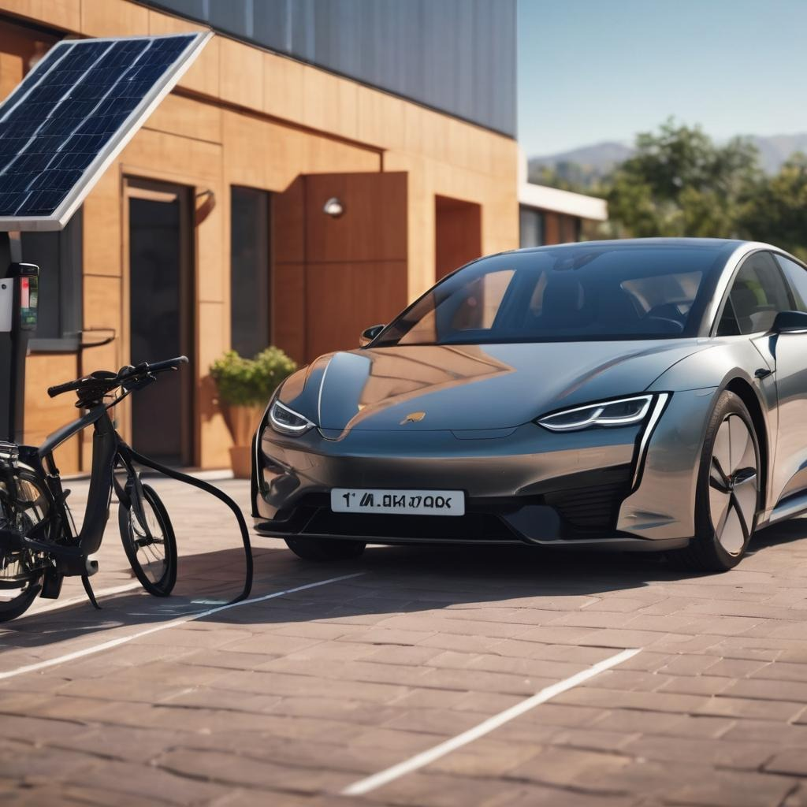
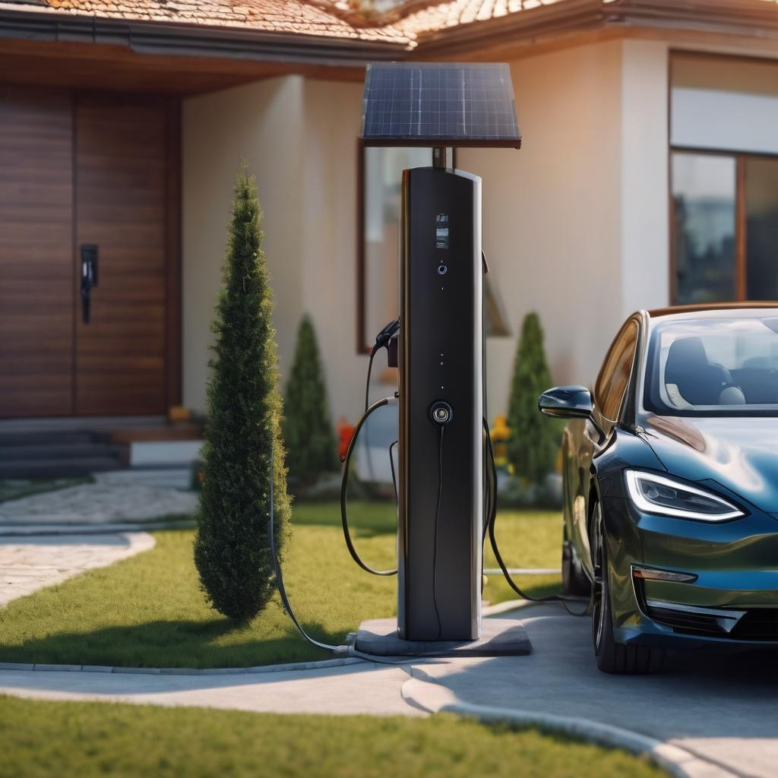
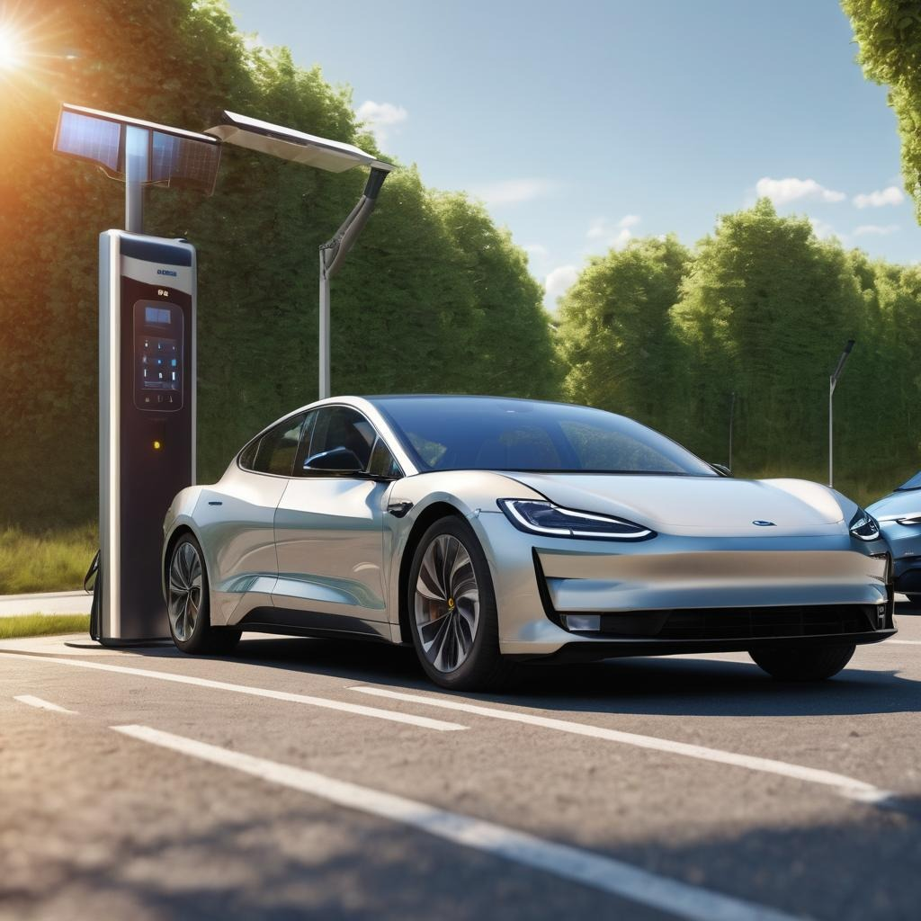
PREDICTED ILLUSTRATION
PREDICTED ILLUSTRATION-PREDICTED ILLUSTRATION-PREDICTED ILLUSTRATION

Slide 6
COST AND MAINTENANCE
The cost and maintenance considerations for setting up a DC Solar Tree, particularly in comparison to traditional DC chargers, represent a significant shift in both affordability and sustainability within the electric vehicle (EV) charging infrastructure landscape. With a price point of approximately 1,74,000 INR, the DC Solar Tree offers an enticing proposition for EV charging solutions. Unlike traditional DC chargers, which can range from 2,00,000 to 10,00,000 INR, the relatively lower upfront cost of the Solar Tree presents an attractive investment opportunity for businesses, communities, and government entities looking to expand EV charging infrastructure. Moreover, the incorporation of solar technology into the charging system underscores a commitment to sustainability and renewable energy integration. By harnessing solar power, the Solar Tree not only reduces operating costs but also minimizes reliance on grid electricity, thus further enhancing its environmental appeal.
COST AND MAINTENANCE-COST AND MAINTENANCE-COST AND MAINTENANCE

Slide 7
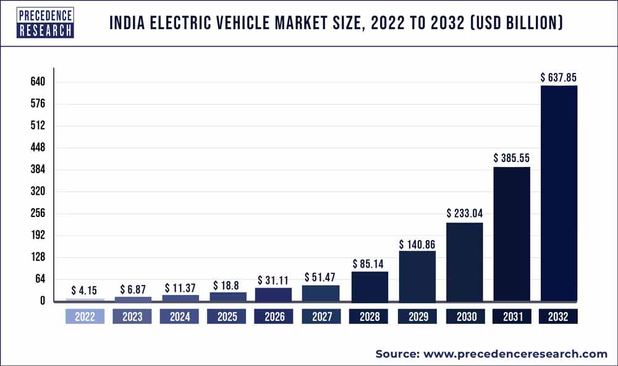
COMMERCIAL REVENUE
Charging Rates: Determine the rate of charge per kilowatt-hour (kWh) for charging sessions. This rate can vary based on factors such as location, competition, and electricity costs. For example, if the charge is ₹10 per kWh, this will be our charging rate.
Average Charging Session: Estimate the average amount of energy consumed per charging session. This can vary based on the types of EVs using your station and their battery capacities. Let's say the average charging session at your station consumes 20 kWh.
Daily Revenue: For example, if your charging rate is ₹10 per kWh and the average session is 20 kWh, your revenue per session is ₹200. If you have 10 sessions per day, your daily revenue would be ₹2000.
Monthly Revenue: For instance, if your station operates 30 days a month, your monthly revenue would be ₹60,000 (₹2000/day * 30 days).
COMMERCIAL REVENUE-COMMERCIAL REVENUE-COMMERCIAL REVENUE

Slide 8

VIDEO REPRESENTATION
*Generated using VideoGen, Generate.AI, Wave*
VIDEO-VIDEO-VIDEO-VIDEO-VIDEO-VIDEO-VIDEO-VIDEO-VIDEO-VIDEO-VIDEO-VIDEO

Slide 9
SWOT ANALYSIS
STRENGTHS
WEAKNESSES
OPPORTUNITIES
THREATS
S
Government support provides political stability, Alignment with national goals fosters collaboration, Environmental benefits contribute to sustainability, Economic opportunities stimulate growth.
W
Cost challenges may hinder scalability, implementation hurdles.
O
Market growth drives expansion and innovation, International collaboration enhances resources and knowledge exchange, Investment in research improves technology and competitiveness.
T
Competitive pressures from other energy sources, Geopolitical risks impact market stability
SWOT ANALYSIS - SWOT ANALYSIS - SWOT ANALYSIS
SWOT ANALYSIS - SWOT ANALYSIS - SWOT ANALYSIS - SWOT ANALYSIS

Slide 10
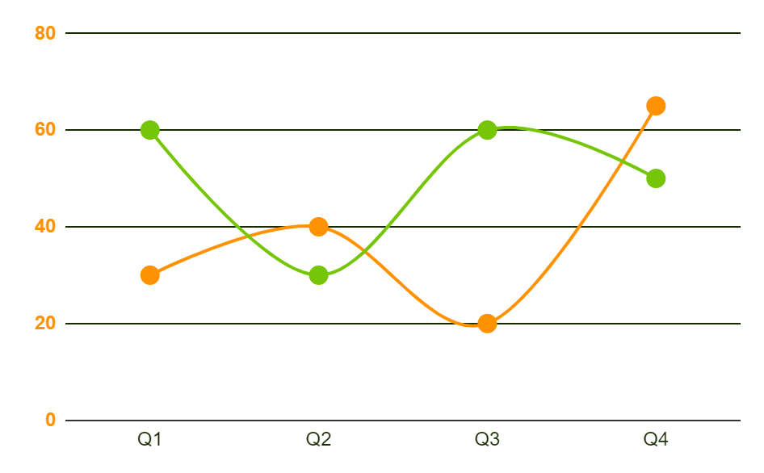
AI ML PART
ML and AI accurately predict real-time climate conditions crucial for managing renewable energy like solar power.
Traditional forecasting methods are inadequate due to the complexity of weather patterns.
ML and AI excel in processing vast datasets and identifying intricate weather patterns.
ML and AI continuously learn from new data inputs, providing real-time insights into upcoming weather conditions.
Proactive decision-making regarding battery charging schedules maximizes energy efficiency.
ML and AI's adaptability ensures continuous refinement of weather prediction accuracy over time.
Optimizing resources through ML and AI prevents underutilization or overcharging of batteries.
ML and AI are essential for efficiently managing renewable energy resources and promoting sustainability.
AIML-AIML-AIML-AIML-AIML-AIML-AIML-AIML-AIML-AIML-AIML-AIML-AIML-AIML

Slide 11
EXPECTED OUTCOMES
Increased Energy Efficiency
Contribution to India’s Renewable Energy Targets
Enhanced Reliability and Resilience
Commercialized Revenue
Cost Savings and Economic Benefits
Environmental Impact
OUTCOME-OUTCOME-OUTCOME-OUTCOME-OUTCOME-OUTCOME-OUTCOME

Slide 12
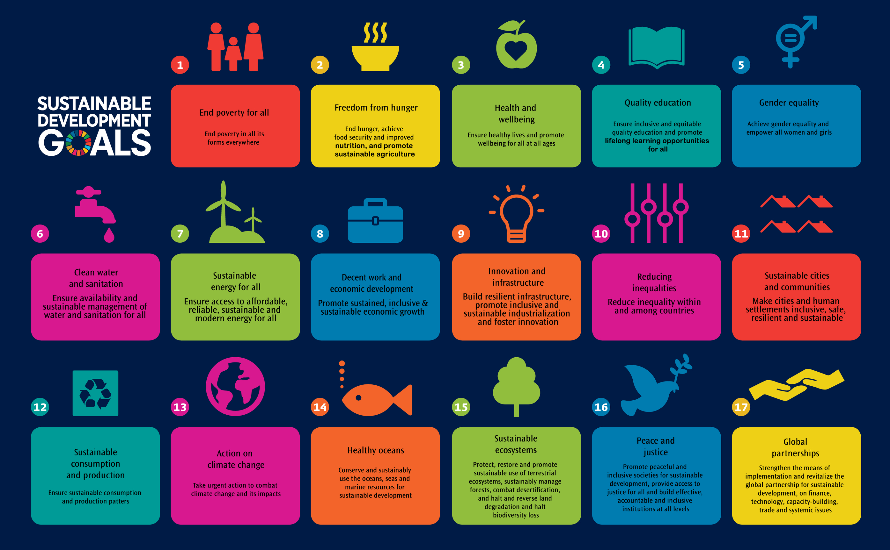
THANK YOU
THANKS! - THANKS! - THANKS! - THANKS!
THANKS! - THANKS! - THANKS! - THANKS!

